Slide 1
CF PROJECT
PRESENTATION

Slide 2
TABLE OF CONTENTS
01
04
About the Project
Sneak Peek
02
05
Major Requirements
Project Stages
03
06
Features
Our Team
Information regarding the company and the product being developed
Here you could describe
the topic of the section
Features that we have included in the website
Here you could describe
the topic of the section
Different features/functioanlity that has been incorporated into the website.
Group members who worked on the project and what their duties were.

Slide 3
OUR COMPANY
Techblaze Collective
TechBlaze Collective aims to revolutionize the digital presence of an IT services business in Qatar. The collective has undertaken a project to develop an interactive and user-centric website to propel the services offered by their company.

Slide 4
ABOUT THE PROJECT
This website will serve as a pivotal platform, showcasing a diverse range of IT solutions and services, laying the groundwork for further enhancements by TechBlaze Collective.

Slide 5

THE TEAM
HAMMAD HAROON SHAH
HUZAIFA KHAWAR
Hammad, as the lead developer, will be responsible for implementing the website's structure, employing HTML, CSS, and JavaScript.
Huzaifa, a pivotal force behind the creative process, will take charge of concept, content and documentation. He will also contribute ideas for the website's concept and design.

Slide 6
FEATURES
HEADER & FOOTER
SECTIONS USING DIVS
BUTTONS

Slide 7
FURTHER FUNCTIONALITY
PLACARDS
IMAGES & ICONS
EFFECTS

Slide 8
MAJOR REQUIREMENTS
IMAGES
USER EXPERIENCE
INFORMATION
Adding relevant images with corresponding text is crucial for enhancing website usability.
The website is divided into specific sections, each featuring its own visuals and information to enhance user experience.
nformation on the site is presented effectively using clear headings, bullet points, and buttons, making it sophisticated yet easy to comprehend.

Slide 9
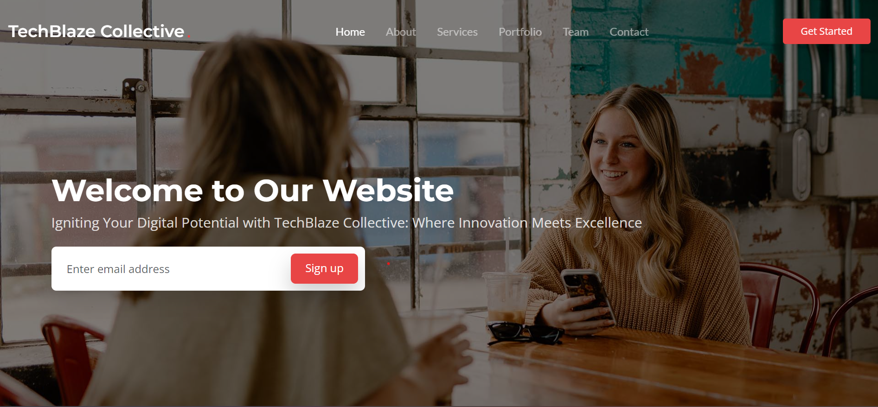
SNEAK PEEK
HEADER
TEXT
SLIDER
ICONS

Slide 10
CONCLUSION
Experience-wise, the aspects that we found the most in implementation were:
Content creation and application using HTML.
Adding the images and varying functionality.
Whereas, implementing some of the CSS and Javascript functionality was the most difficult.
However, we did learn a lot about HTM structuring and different CSS styling processes, which had it not been for this project would have been difficult to learn for us otherwise. Furthermore, the proposed benefits can be realized by the system but if we could do it all over again, we would probably add more Javascript functionality such as a login system and contact section.

Slide 11
THANK YOU!
8

